Slide 1
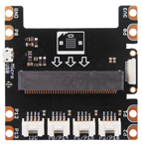
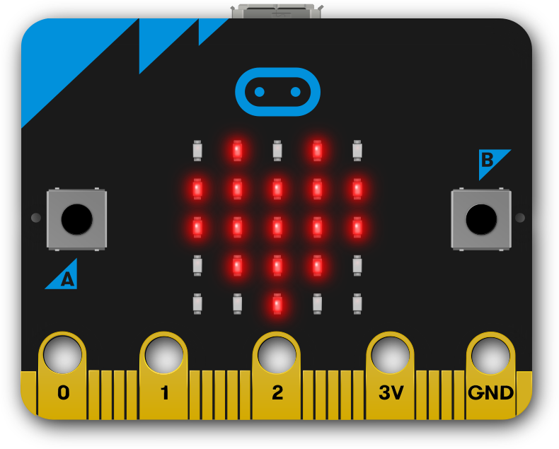
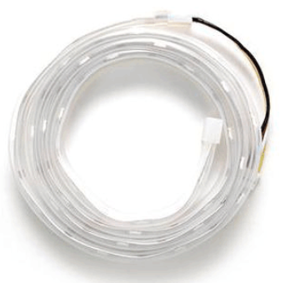
Using Python to Control WS2812 RGB LED Flexi-Strip
MicroPython

Slide 2
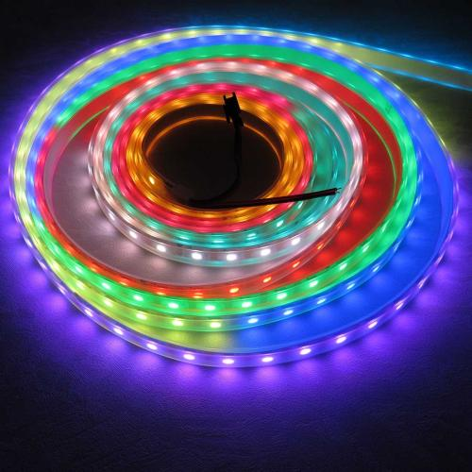
WS2812 RGB LED Flexi-Strip
Neopixel strip is made up of a series of special LEDs that can be controlled using only one IO.
WS2812 has an internal control chip which can control the red, green, and blue LED. Every LED can show 2⁸ = 256 kinds of color. With three colors combined, it can show 256 x 256 x 256 = 16777216 kinds of color.
It’s very easy to control strip with micro:bit.

Slide 3
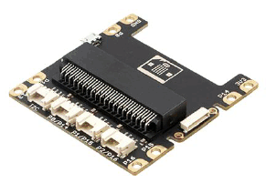
Experiment Equipment
micro:bit x 1
From grove inventor kit:
Base Shield x 1
WS2812 strip x 1
Micro USB cable(Android data cable)
Network-enabled computer

Slide 4
Hardware Connection
First, plug micro:bit into Grove Shield for micro:bit v2.0
Then, connect the strip to the port labeled with P1/P15(It’s OK to use other port, only if you modify the control port later)
Finally, connect micro:bit to PC via micro USB cable.

Slide 5
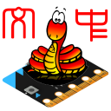
Software
Chrome kernel web browser(version greater than 67)
PythonEditor community https://micropython.top/
Update DAPLink firmware of micro:bit to greater than 0247 which support webusb.

Slide 6
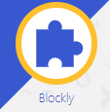
Software
Using Chrome web browser
Goto https://micropython.top
Click Blockly to change to Blocks Editor

Slide 7
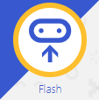
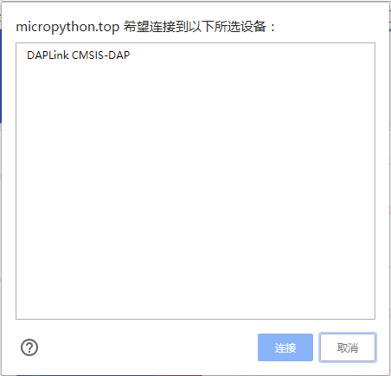
Download the program
After you finish writing the program, click Flash and you can download the program by webusb.
In the pop-up selection box, the program will be downloaded and run automatically after you select the device.

Slide 8

Download the program in traditional way
If you haven’t update the firmware, you have to download the HEX file and paste it into microbit to run.

Slide 9
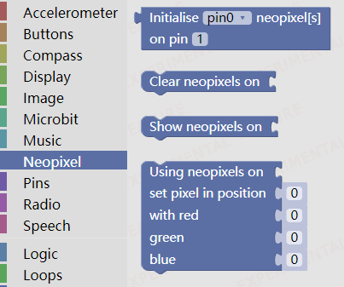
Blocks of Neopixel
From navbar on the leftside, you can find a category named Neopixel, it has four function to control the Neopixel.

Slide 10
Function Description of Blocks
These blocks will be used to set which and how many pins controling the neopixels, turn off lights, refresh color setting, and set colors of neopixels.
You can use any pin to control neopixel, and the quantity could be from 1 to 256.It’s OK if you have more. However, micro:bit has small memory, too large a number will make program easier to go wrong and lights may go dim for the power of Grove Shield is not large enogh.

Slide 11
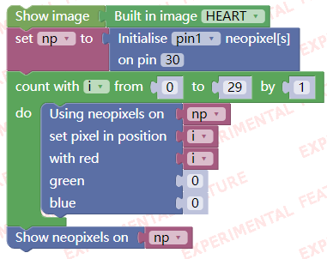
Blocks Editing
Program below shows the basic way to control neopixels. The case shows the pattern of red light from dim to bright.
Use pin1 to control, the number of lights of neopixels in the kit is 30.

Slide 12
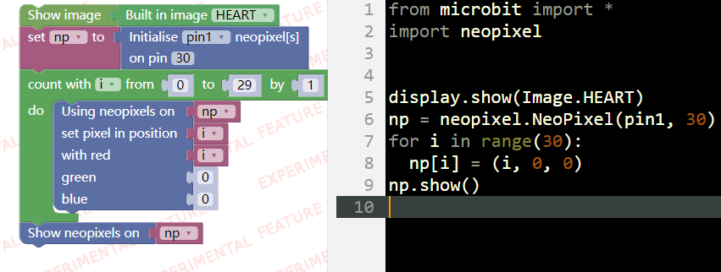
Blocks & Code
When you are using blocks to program, the corresponding Python code will be shown on the right side of the page.

Slide 13
Program with Code
The picture below shows the corresponding code of the blocks. Campare to using blocks to make program, code is more concise and efficient.
from microbit import * import neopixel display.show(Image.HEART) np = neopixel.NeoPixel(pin1, 30) for i in range(30): np[i] = (i, 0, 0) np.show()

Slide 14
Controlling Neopixels
From the previos program we can tell that the basic way to control neopixels is:
Define the number of neopixels, set the controlling pin and the number of neopixels(The number of neopixlels from Grove kit is 30)
Set the color of light (one LED at a time)
Using function show() to light up the LED
We can see that it’s quite easy to control neopixels. Using basic control and different algorithms to change the color regularly, we can make different patterns. Now we’ll see how it works.

Slide 15
Neopixels Program 1：Stars Shining
Pattern: LEDs of the neopixels light up randomly, mimic the way of stars shining at night.
How to make it work:
Choose 3 LEDs from neopixel randomly
Set the color of these three LEDs randomly
Light up LEDs quickly to mimic the way stars shine
Turn off LEDs after delay

Slide 16
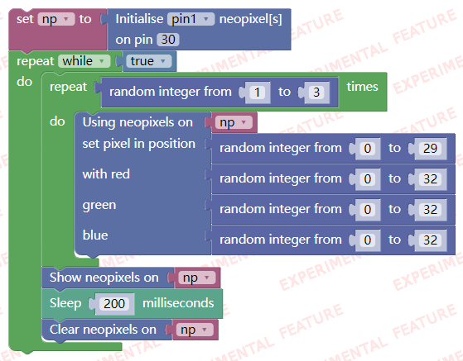
Star Shining

Slide 17
Code of Star Shining
import neopixel import random from microbit import * np = neopixel.NeoPixel(pin1, 30) while True: for count in range(int(random.randint(1, 3))): np[(random.randint(0, 29))] = ((random.randint(0, 32)),\ (random.randint(0, 32)),\ (random.randint(0, 32))) np.show() sleep(200) np.clear()

Slide 18
Neopixels Prgram 2: Breathing Light
Pattern: The whole neopixels light up gradually and then dim gradually.
How to make it work：
Increase or Decrease the color of LED(we take red for example later)
Increase from 0 and decrease when it reaches apex

Slide 19
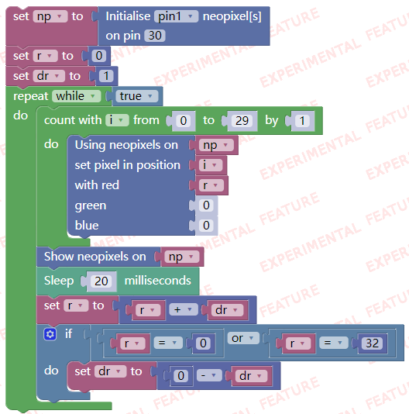
Breathing Light

Slide 20
Code of Breathing Light
import neopixel from microbit import * np = neopixel.NeoPixel(pin1, 30) r = 0 dr = 1 while True: for i in range(30): np[i] = (r, 0, 0) np.show() sleep(50) r = r + dr if r == 0 or r == 32: dr = 0 - dr

Slide 21
Neopixels Program 3: Breathing Light + Star Shining
Pattern: Combine the last two examples,to show that random lights light up and dim gradually.
How to make it works：
Combine the methods we use in making star shining and breathing light
Use random number to produce the change in 3 colors

Slide 22
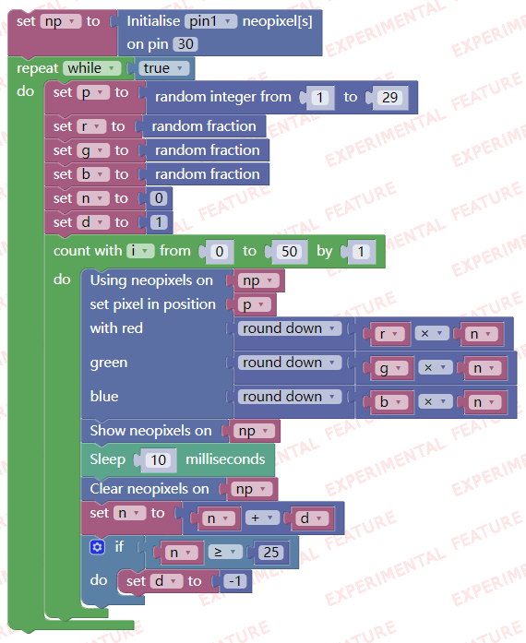
Breathing Light + Star Shining

Slide 23
Code of Breathing Light + Star Shining
import neopixel import random import math from microbit import * np = neopixel.NeoPixel(pin1, 30) while True: p = random.randint(0, 29) r = random.random() g = random.random() b = random.random() n = 0 d = 1 for i in range(51): np[p] = ((round(r * n)), (round(g * n)), (round(b * n))) np.show() sleep(10) np.clear() n = n + d if n >= 25: d = -1

Slide 24
Neopixels Program4：Flow LED
Pattern: Light up LEDs on the strip one by one, to make it look like the lights are flowing
How to make it work：
Set a variable r, representing the position of LED
Set the color of LED, light up the strip, turn them off after a delay
Increase 4, when reaching its maximum number 30, it becomes 0
Only one LED light up at a time, and one by one

Slide 25
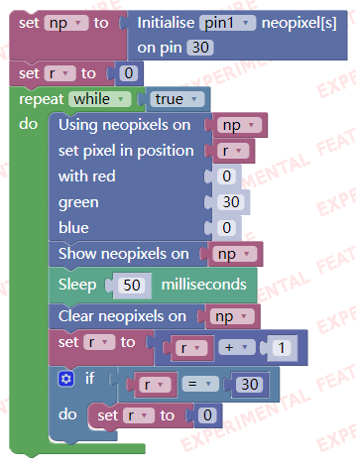
Flow LED

Slide 26
Code of Flow LED
import neopixel from microbit import * np = neopixel.NeoPixel(pin1, 30) r = 0 while True: np[r] = (0, 30, 0) np.show() sleep(50) np.clear() r = r + 1 if r == 30: r = 0

Slide 27
Change of Flow LED
Use different way to control flow LED, we can make different patterns of flow LED.
Round Trip flow LED
Color changing flow LED
Variable speed flow LED
……

Slide 28
Color Changing Flow LED
import neopixel import random from microbit import * np = neopixel.NeoPixel(pin1, 30) c = (0, 30, 0) while True: np[r] = c np.show() sleep(50) np.clear() r = r + 1 if r == 30: r = 0 c = (random.randint(0, 32),\ random.randint(0, 32),\ random.randint(0, 32))

Slide 29
Variable Speed Flow LED
import neopixel import random from microbit import * np = neopixel.NeoPixel(pin1, 30) c = (0, 30, 0) d = 50 while True: np[r] = c np.show() sleep(d) np.clear() r = r + 1 if r == 30: r = 0 c = (random.randint(0, 32),\ random.randint(0, 32),\ random.randint(0, 32)) d = random.randint(20, 120)

Slide 30
Round Trip Flow LED
import neopixel import random from microbit import * np = neopixel.NeoPixel(pin1, 30) c = (0, 30, 0) dr = 1 while True: np[r] = c np.show() sleep(50) np.clear() r = r + dr if r == 29 or r == 0: dr = -dr c = (random.randint(0, 32),\ random.randint(0, 32),\ random.randint(0, 32))

Slide 31
Neopixels Program：Spinning Rainbow
Pattern: Set the color of strip to gradient rainbow color, and show in spinning way.
How to make it works：
Define function np_rainbow(np, num, bright, offset) to set the color of the strip.
num is the number of LEDs in the strip
bright is the greatest brightness
offset is the starting position
Divide the strip into 7 equally, set the color of each LED according to the color of the rainbow.
By decreasing offset to make the effect of spinning

Slide 32
Code of Spinning Rainbow
from microbit import * import neopixel np = neopixel.NeoPixel(pin1 ,32) def np_rainbow(np, num, bright=32, offset = 0): rb = ((255,0,0), (255,127,0), (255,255,0), (0,255,0),\ (0,255,255), (0,0,255), (136,0,255), (255,0,0)) for i in range(num): t = 7*i/num t0 = int(t) r = round((rb[t0][0] + (t-t0)*(rb[t0+1][0]-rb[t0][0]))*bright)>>8 g = round((rb[t0][1] + (t-t0)*(rb[t0+1][1]-rb[t0][1]))*bright)>>8 b = round((rb[t0][2] + (t-t0)*(rb[t0+1][2]-rb[t0][2]))*bright)>>8 np[(i+offset)%num] = (r, g, b) n = 0 while 1: np_rainbow(np, 30, offset = n) np.show() n += 1 sleep(30)

